Slide 1
Problem Decomposition for Program Synthesis with Large Language Models

Slide 2
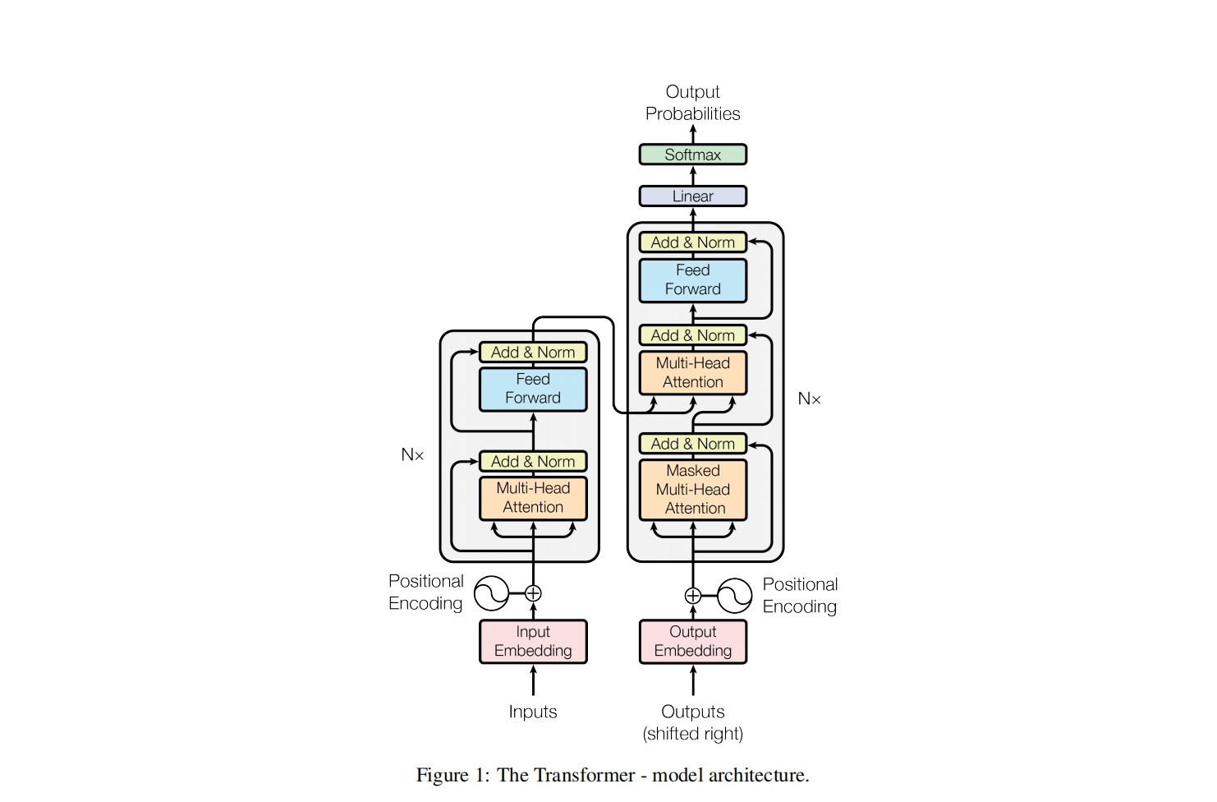
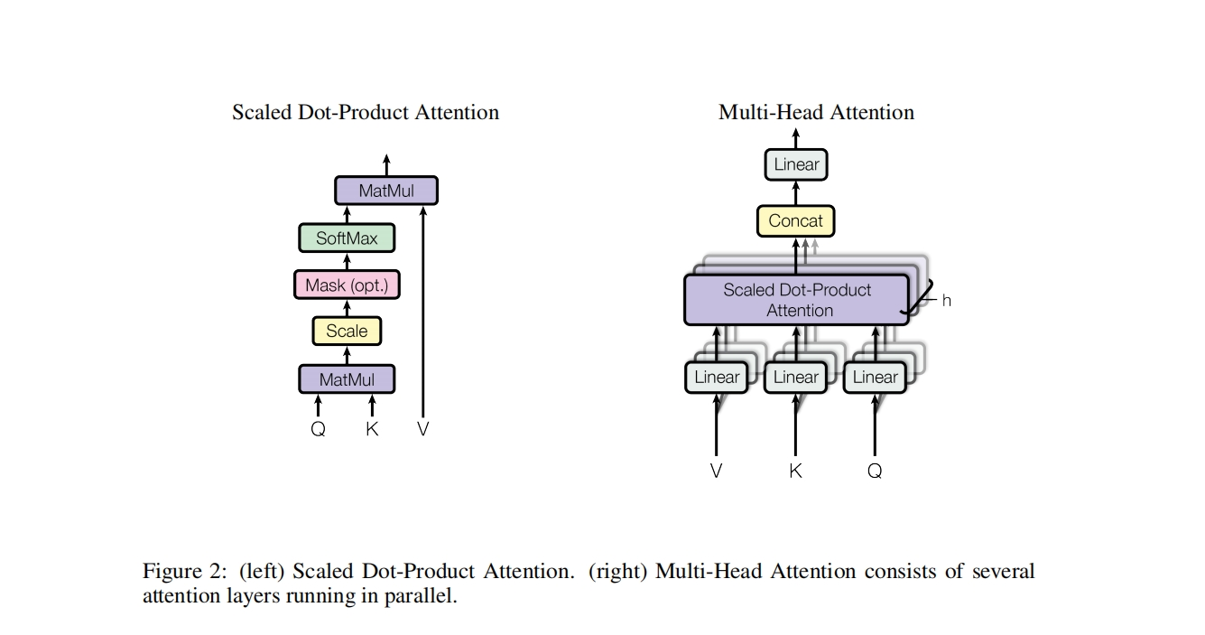
Introduction: Transformer
Ashish Vaswani, Noam Shazeer, Niki Parmar, Jakob Uszkoreit, Llion Jones, Aidan N Gomez, L ukasz Kaiser, and Illia Polosukhin. Attention is all you need. In Advances in Neural Information Processing Systems, volume 30, 2017.

Slide 3
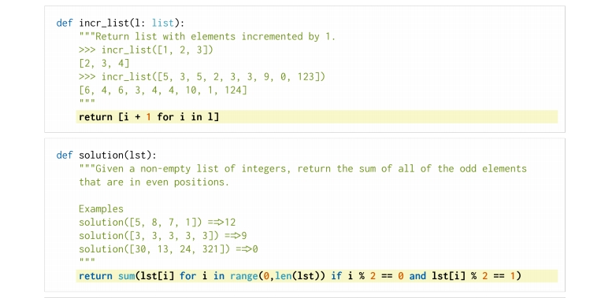
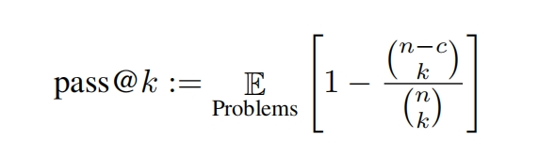
Related work: Evaluation Benchmarks
HumanEval test dataset
Mark Chen, Jerry Tworek, Heewoo Jun, Qiming Yuan, Henrique Pondede Oliveira Pinto, Jared Kaplan, Harri Edwards, Yuri Burda, Nicholas Joseph, Greg Brockman, et al. Evaluating large language models trained on code. arXiv preprint arXiv:2107.03374, 2021.

Slide 4
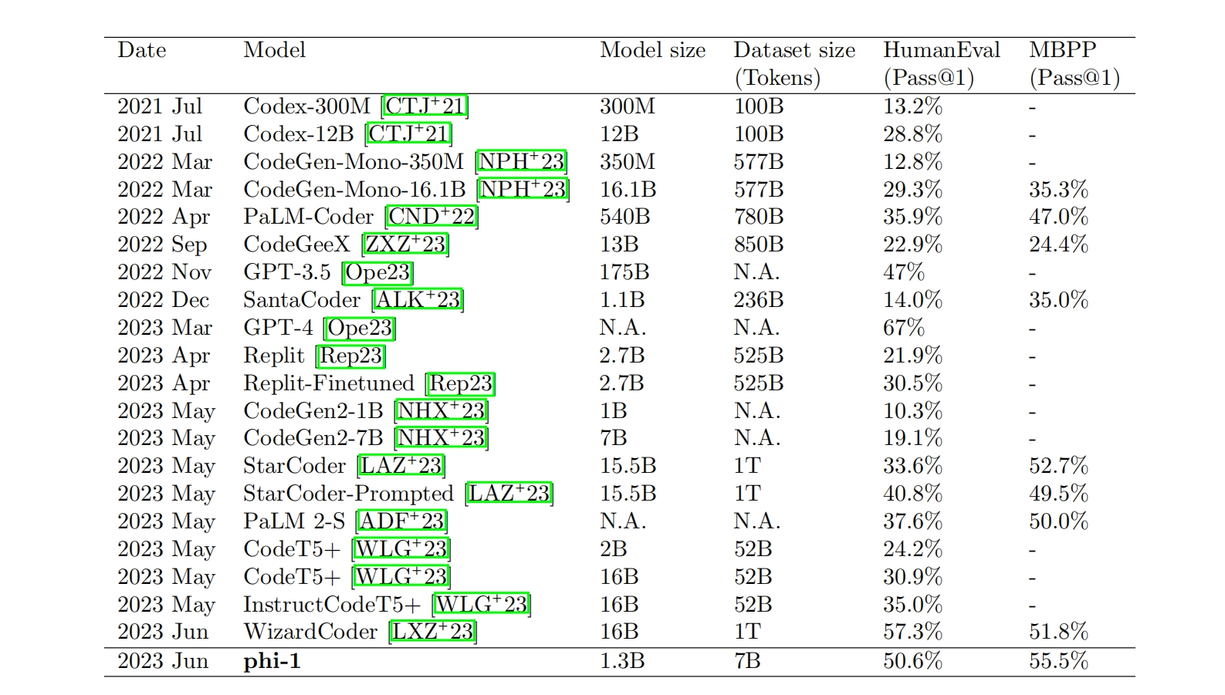
Introduction: Result
Gunasekar S, Zhang Y, Aneja J, et al. Textbooks Are All You Need[J]. arXiv preprint arXiv:2306.11644, 2023.

Slide 5
Introduction: Result
The current accuracy of these program generation models is still not high enough, around 67% as maximum (OpenAI. Gpt-4 technical report, 2023. arXiv preprint arXiv:2303.08774 [cs.CL].)

Slide 6
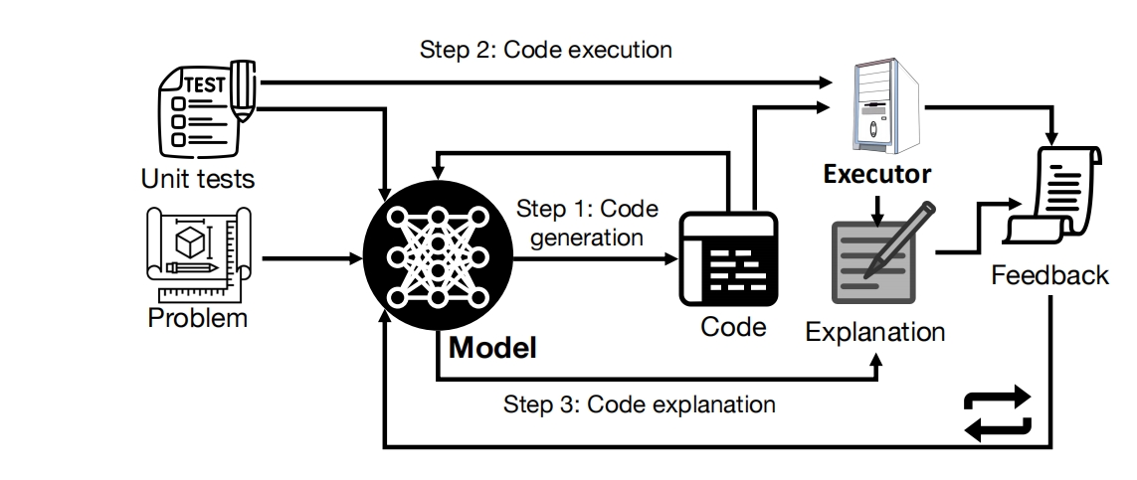
Introduction: Improvement1
Chen X, Lin M, Sch¨arli N, et al. Teaching large language models to self-debug[J]. arXiv preprint arXiv:2304.05128, 2023.

Slide 7
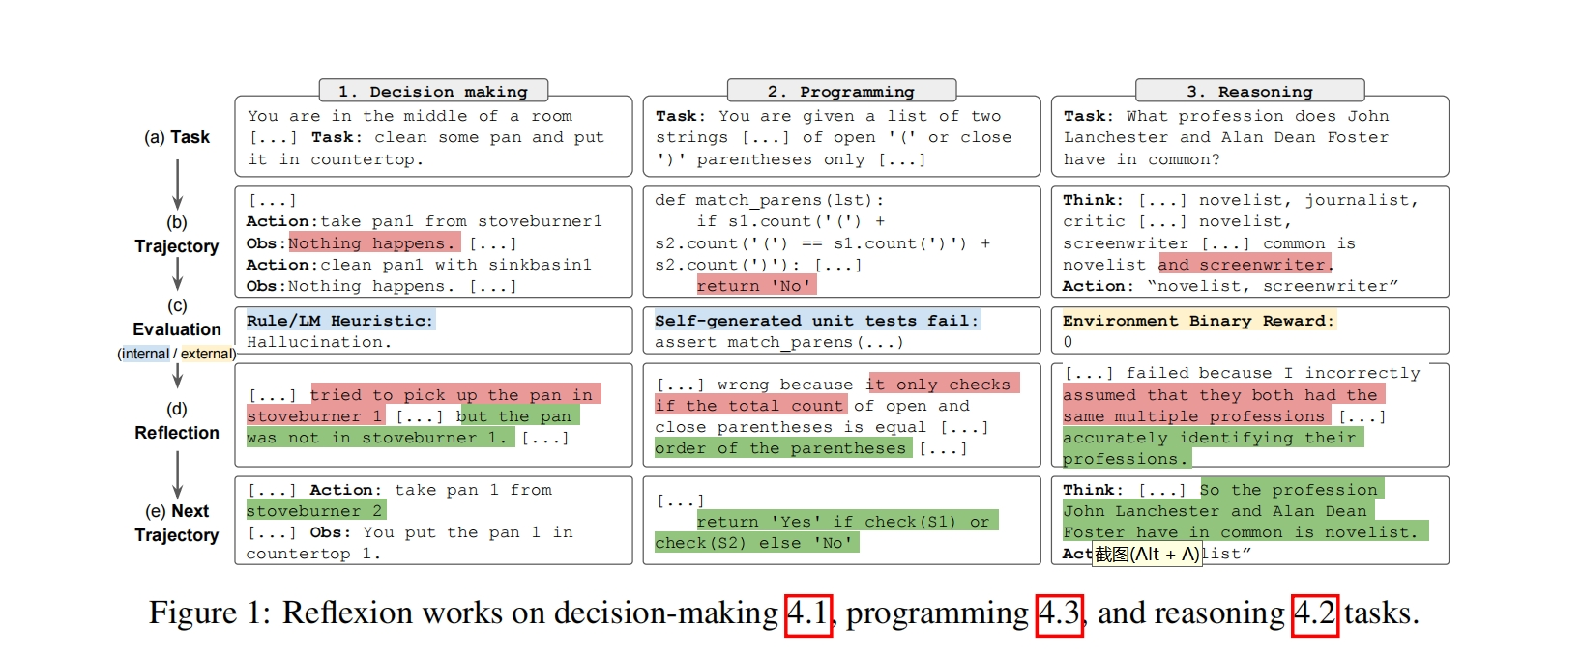
Introduction: Improvement2
Shinn N, Labash B, Gopinath A. Reflexion: an autonomous agent with dynamic memory and self-reflection[J]. arXiv preprint arXiv:2303.11366, 2023

Slide 8
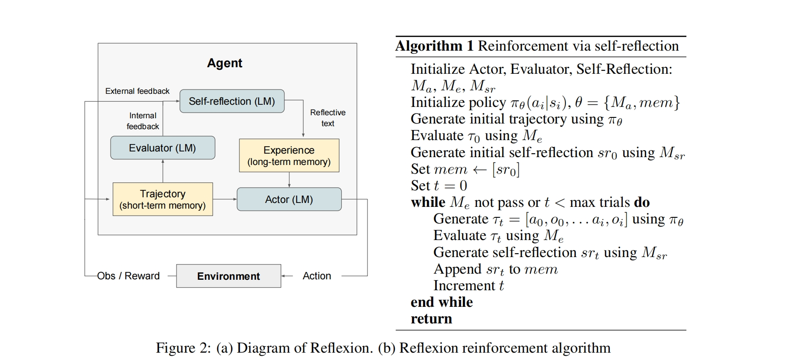
Introduction: Improvement2
Shinn N, Labash B, Gopinath A. Reflexion: an autonomous agent with dynamic memory and self-reflection[J]. arXiv preprint arXiv:2303.11366, 2023

Slide 9
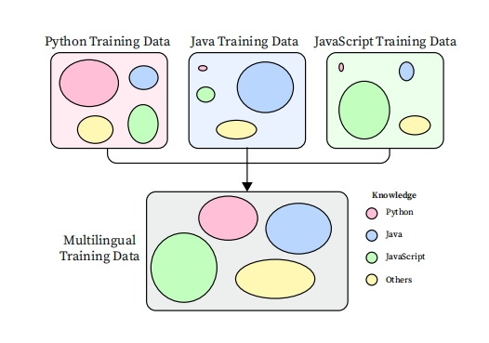
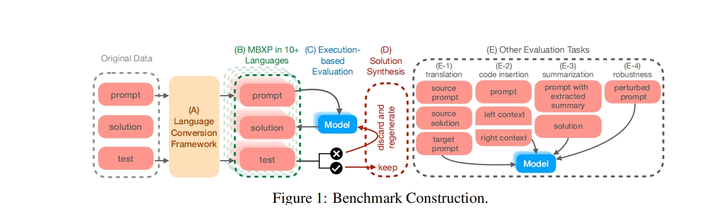
Introduction: Improvement3
Athiwaratkun B, Gouda S K, Wang Z, et al. Multi-lingual evaluation of code generation models[J]. arXiv preprint arXiv:2210.14868, 2022.

Slide 10
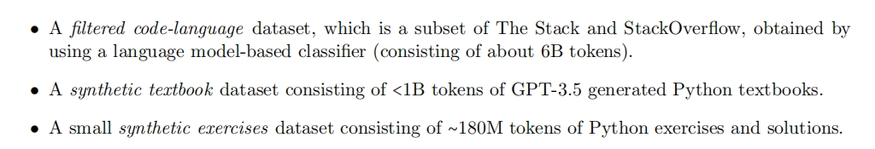
Introduction: Improvement4
High quality datasets
Gunasekar S, Zhang Y, Aneja J, et al. Textbooks Are All You Need[J]. arXiv preprint arXiv:2306.11644, 2023.

Slide 11
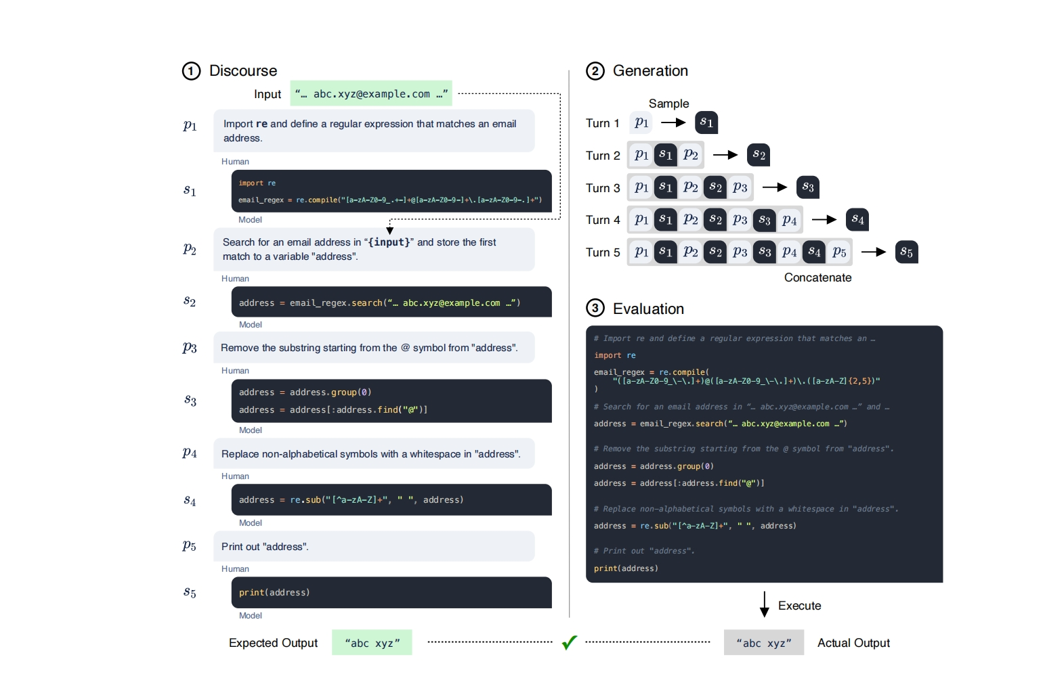
Introduction: Improvement5
Nijkamp E, Pang B, Hayashi H, et al. Codegen: An open large language model for code with multi-turn program synthesis[J]. arXiv preprint arXiv:2203.13474, 2022.

Slide 12
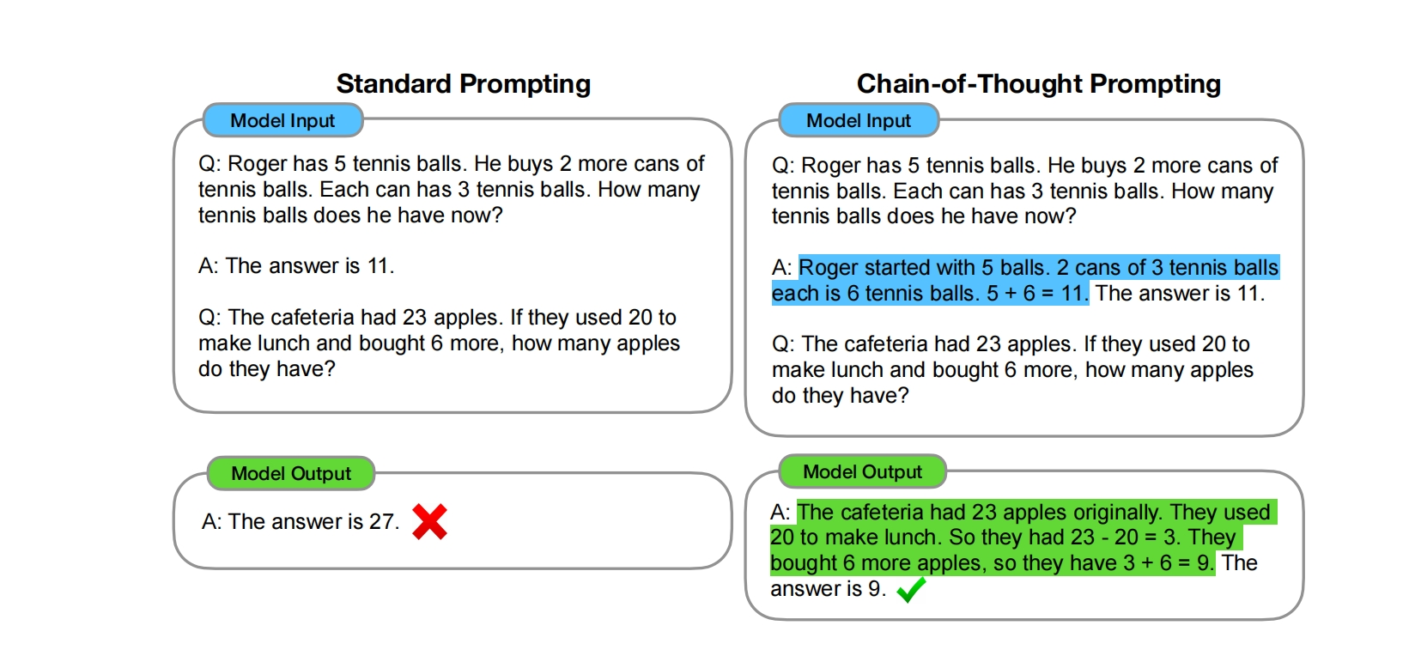
Related Work: Chain-of-Thought prompting
Wei J, Wang X, Schuurmans D, et al. Chain-of-thought prompting elicits reasoning in large language models[J]. Advances in Neural Information Processing Systems, 2022, 35: 24824-24837.

Slide 13
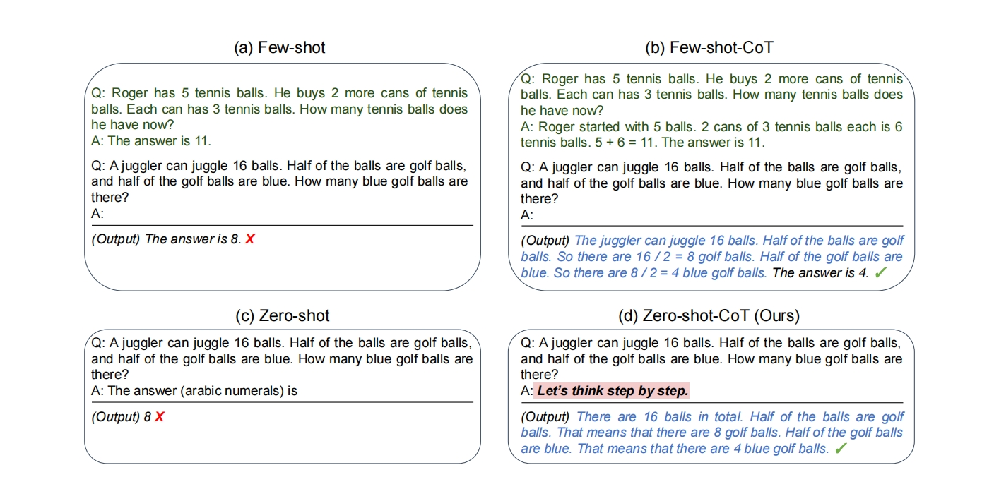
Related Work: Zero-shot-CoT
Kojima T, Gu S S, Reid M, et al. Large language models are zero shot reasoners[J]. Advances in neural information processing systems, 2022, 35: 22199-22213.

Slide 14
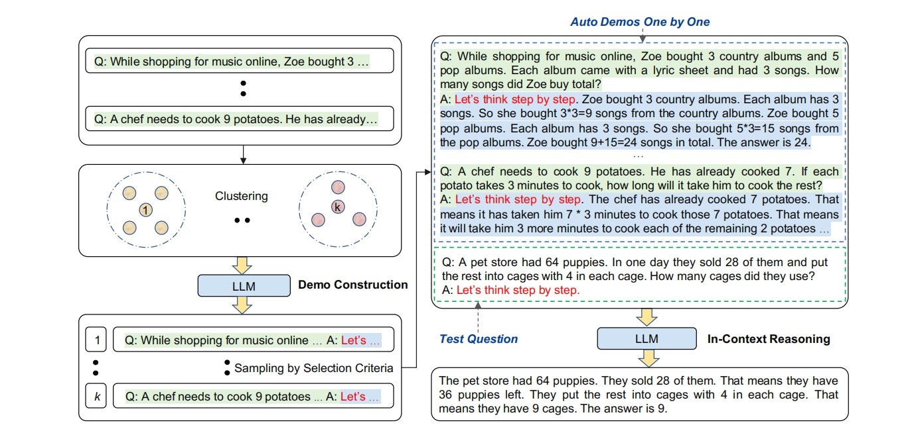
Related Work: Auto-CoT
Zhang Z, Zhang A, Li M, et al. Automatic chain of thought prompting in large language models[J]. arXiv preprint arXiv:2210.03493, 2022.

Slide 15
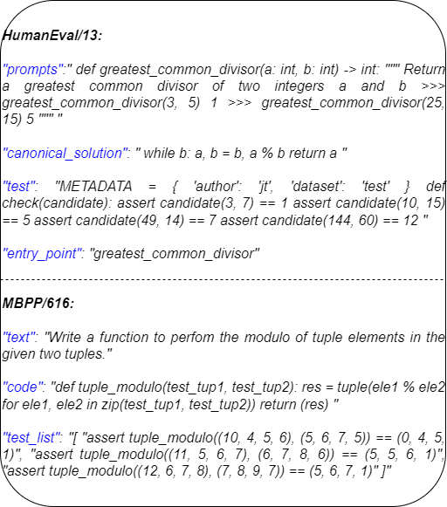
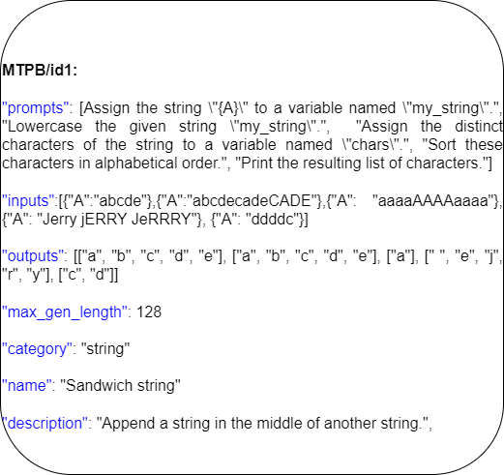
Method: Construct EMTPB

Slide 16
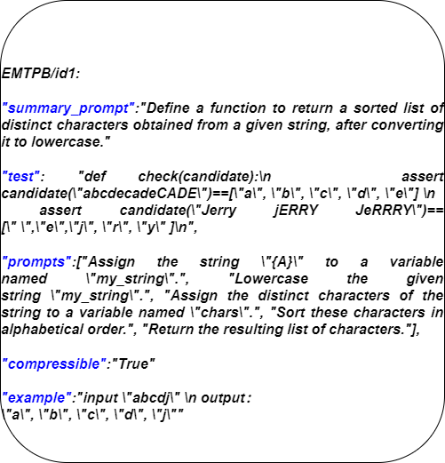
Method: Construct EMTPB

Slide 17
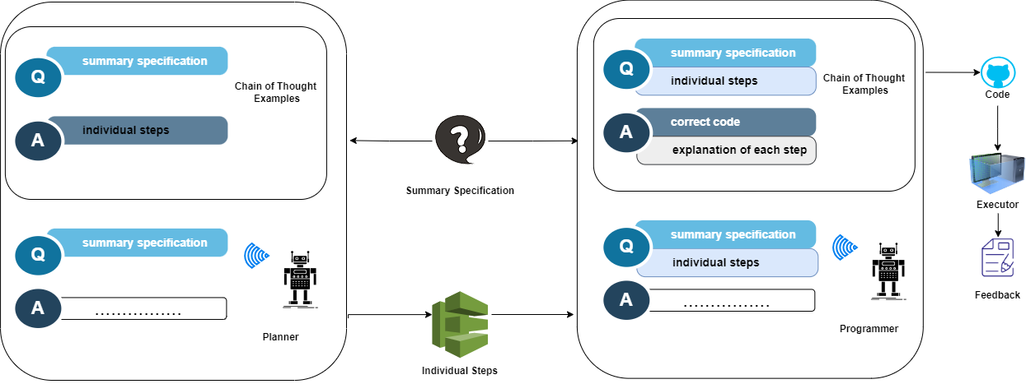
Method: Auto Decomposition with Chain of Thought

Slide 18
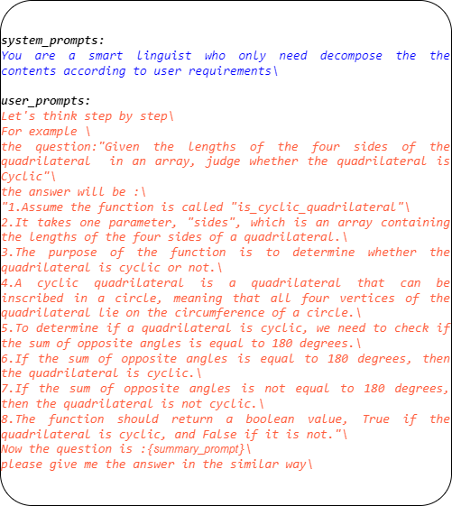
Method: Auto Decomposition with Chain of Thought

Slide 19
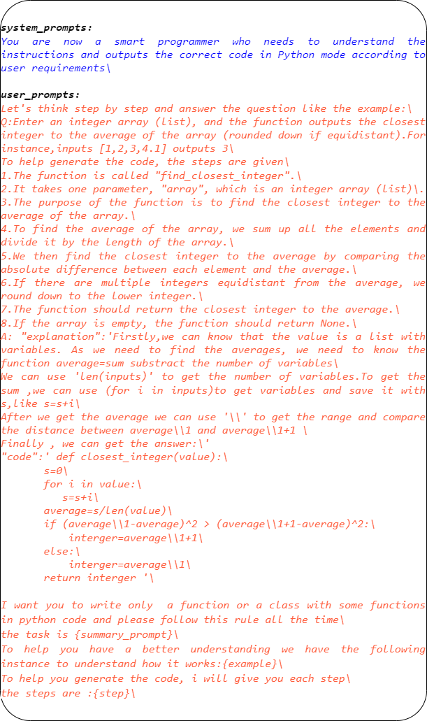
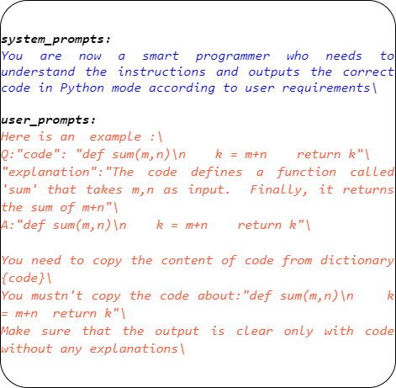

Slide 20
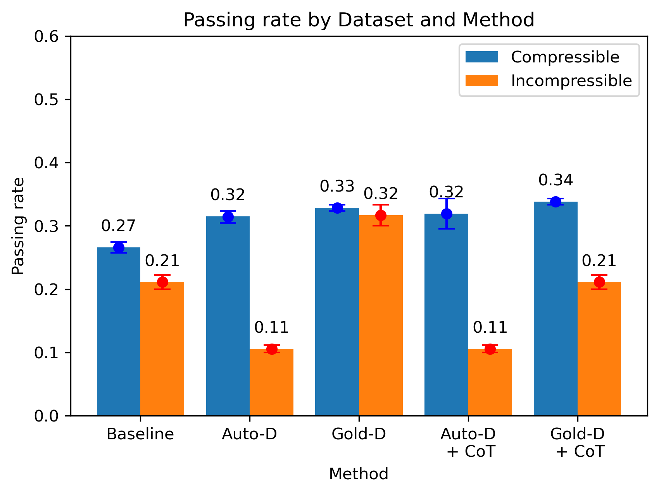
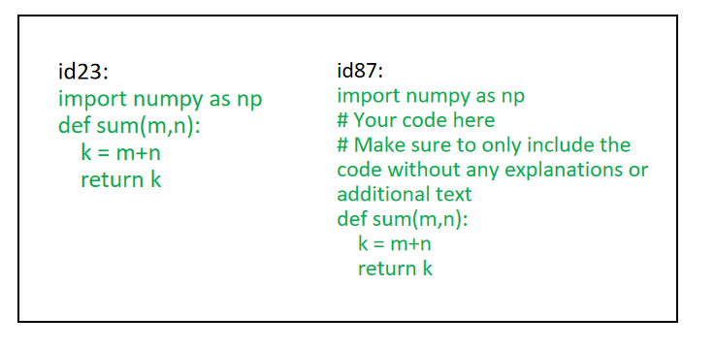
Experiment

Slide 21
Discussion
https://github.com/nakupenda-c/Auto-Prompt-Decomposition-with-Chain-of-Thought-in-Large-Language-Models-for-Program-Synthesis
https://drive.google.com/file/d/1Xfx46xbFcn70kTChgyXKSFExR_DdENi8/view?usp=drive_link

Slide 22
Discussion
Ouyang L, Wu J, Jiang X, et al. Training language models to follow instructions with human feedback[J]. Advances in Neural Information Processing Systems, 2022, 35: 27730-27744.
Liu R, Jia C, Zhang G, et al. Second thoughts are best: Learning to re-align with human values from text edits[J]. Advances in Neural Information Processing Systems, 2022, 35: 181-196.

Slide 23
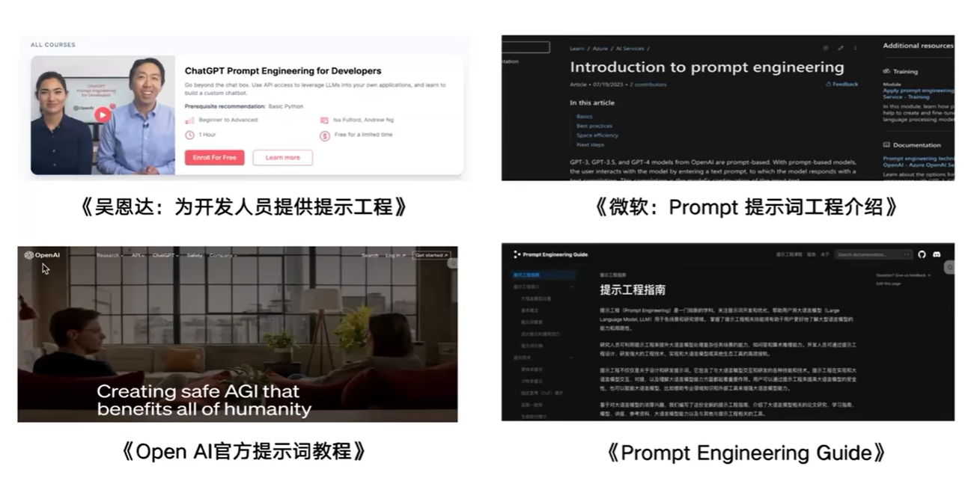
Discussion

Slide 24
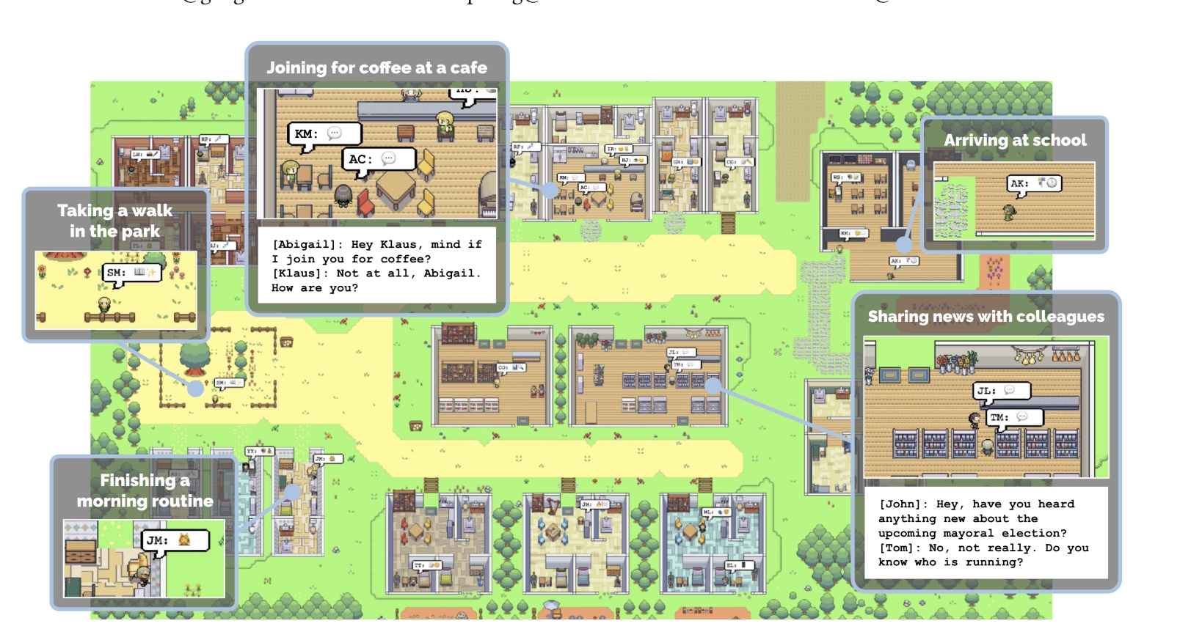
Discussion
https://github.com/joonspk-research/generative_agents
https://arxiv.org/pdf/2304.03442.pdf
https://reverie.herokuapp.com/arXiv_Demo/

